Slide 1
An introduction to working with gender diverse young people
Sophie and Adam

Slide 2
Girl toys vs boy toys: The experiment
https://www.youtube.com/watch?v=nWu44AqF0iI

Slide 3
Who has had experience of working with CYP where gender identity is a factor?

Slide 4
Key words
Gender diversity/nonconformity
The extent to which a person’s gender identity, role or expression differs from the cultural norms prescribed for people of a particular sex
Gender dysphoria
The marked incongruence between one’s experienced/expressed gender and birth-assigned gender (based on physiological sex characteristics).
Of at least 6 months duration and associated with clinically significant distress or impairment in social, occupational or other important areas of functioning
Social transition
Identifying as a new gender (i.e. no medical intervention)

Slide 5
GIDS
Gender Identity Development Service
Established in 1989
Main bases in London (Tavistock) and Leeds
CYP up until the age of 18

Slide 6
Demographics
Many more older teenagers than primary school children. Of the younger children they do see, many have socially transitioned before going to the service.
Currently seeing more people assigned female at birth (though not for the youngest children)
CYP with a diagnosis of ASC are over-represented, particularly in birth assigned females
Disproportionately high number of CLA
Increasing numbers presenting in mid-teens with no history of gender dysphoria
Range of different identities, e.g. non-binary
Not everyone will continue to identify as trans or non-binary
Notes:
Point about ASC:
Growing research in area – ask EPs if they have seen a link?
Male brain ideas; fixed pathway/understanding; boundary between special interest and identity; are those with ASC acting out of a non-binary way from a younger age?

Slide 7
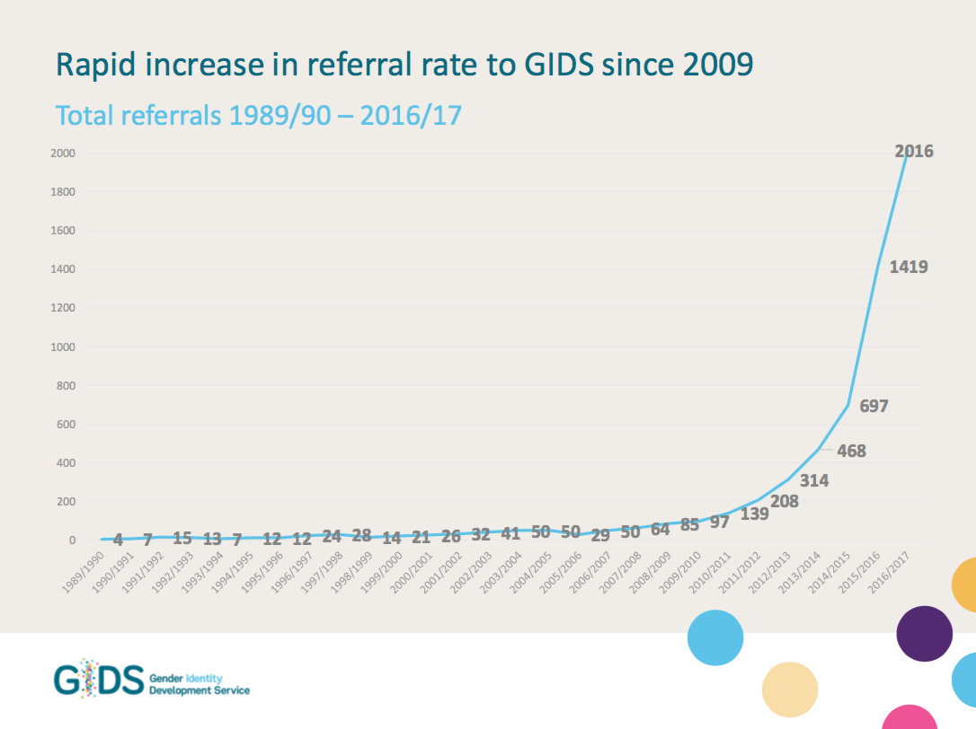

Slide 8
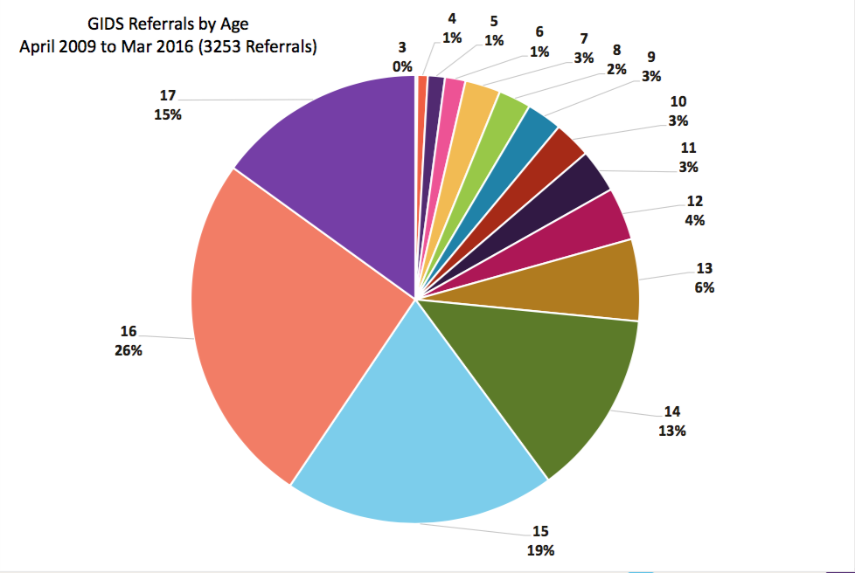

Slide 9
GIDS
Multi-disciplinary team: families often seen by a pair of workers
Holistic, psychosocial assessment typically consisting of 4-6 appointments over 6 month period
Ongoing psychological input
Groups and family days
Staged approach to physical intervention
Transitions to adult services
Notes:
1. Linking with CAMHS – very important
Focus on gender roles in the family and getting to know you time. Over time – useful as part of adolescent identity development and important factor before making decisions
6. 17+ new patients can be referred to adult services through GPs

Slide 10
Aims of the GIDS
Encouraging parents and YP where possible to hold lightly any sense of certainty when it comes to longer term outcomes
Helping parents/YP have the space to make informed choices
Encouraging YP to try out and experiment with a range of identities
Be mindful of the urge to ask why, but instead ask how are YP living their gender and what do they need to do this well

Slide 11
Common topics during assessment
Past and current gender feelings and changes over time;
Exploration of gender identity feelings – Adolescents are increasingly seeking to be another, not necessarily ‘the opposite’, gender;
What transition the YP has made/is considering;
The nature and intensity of any distress;
Experiences of puberty or anticipated ideas about pubertal development;
Parents’ or carers’ stance towards the child’s gender, point at which they knew about gender feelings;
Associated difficulties and ability to give informed consent;
Relationships in the family and wider context;
Significant life events for the whole family;
Relevant parental or family spiritual, religious and cultural beliefs.

Slide 12
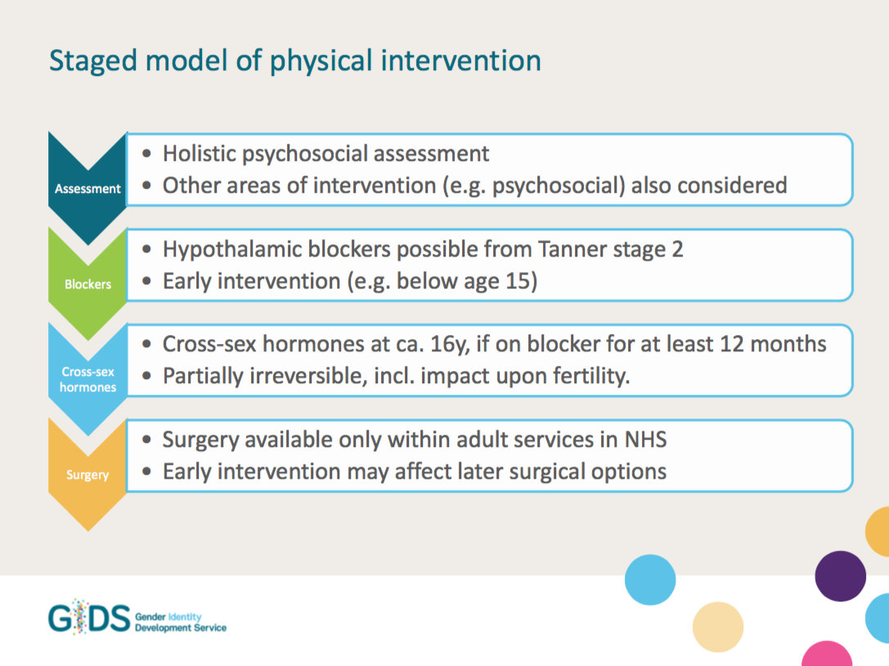
Notes:
Assessment:
Refer back to the 4-6 sessions (Focus on gender roles in the family and getting to know you time. Over time – useful as part of adolescent identity development and important factor before making decisions)
Approx one third go forward for clinical intervention
Encourage CYP to hold slightly any sense of certainty – much change happens for CYP naturally (identity)
Blockers:
Used when CYP are highly distressed
Halts puberty - reaching a neutral body state
Medically reversible (but not psychologically) – so still a period of exploration – can come off and readjust (puberty continues from where it left off)
Used for at least one year and until at least 16 years of age (can start on these when under 10 since 2010)
Cross-sex hormones:
Considered carefully over time
10% are from BME groups

Slide 13
Buying time or arresting development?
(Giovanardi, 2017)
Many professionals are critical of early pubertal suppression. They argue:
YP is not sufficiently mature or authentically free to make such a decision;
Impossible to make a GD diagnosis with any certainty in adolescence because gender identity is still fluctuating;
Puberty suppression may inhibit a ‘spontaneous formation’ of a consistent gender identity, which sometimes develops through a crisis of gender;
Considering the high proportion of desisters, early physical treatment may be premature and inappropriate;
Research about the effects of early intervention on the development of bone mass and growth and on brain development is still limited – can’t know long term effects;
Impact on sexuality not studied – blocking of hormones may prevent age-appropriate socio-sexual experiences;
May limit exploration of sexual orientation.

Slide 14
Discussion: Have you asked yourself?
(sharing only what you are comfortable with)
How do you identify currently in terms of your sexuality and gender identity?
At what point did you realise that you were male, female, gender fluid, queer, straight, gay, lesbian, bisexual, etc.? And how did your parents react?
What factors might have contributed to the development of your sexuality and gender identity? What has constrained or facilitated exploration of these over time?
Do you think it will change in the future? How do you know?
When are you at your most masculine/feminine/gender neutral? To what extent does your gender expression vary across contexts? Has this got anything to do with your sexuality and if so, what?
How has your experience of gender and sexuality impacted your life choices and how do you understand others’ identities?

Slide 15
Gender Dysphoria
Gender diversity/nonconformity
The extent to which a person’s gender identity, role or expression differs from the cultural norms prescribed for people of a particular sex
Gender dysphoria
The marked incongruence between one’s experienced/expressed gender and birth-assigned gender (based on physiological sex characteristics).
Of at least 6 months duration and associated with clinically significant distress or impairment in social, occupational or other important areas of functioning
Only some gender diverse people experience gender dysphoria at some point in their lives.

Slide 16
Gender Dysphoria
In children – strong desire to be of the other gender/insistence that he/she is the other gender.
Plus, at least 5 from:
(Strong) Preference for cross-dressing;
Cross-gender roles in make-believe play;
Toys/games of the other gender;
Playmates of the other gender;
Rejection of gender-typical play;
Dislike of sexual anatomy;
Desire for primary and/or secondary sex characteristics that match one’s experienced gender.
Notes:
There may or may not be a diagnosis when referred to the service
Rarely diagnosed at a younger age

Slide 17
Gender Dysphoria
In adolescents/adults – at least 2 from:
Marked incongruence between experienced/expressed gender and primary and/or secondary sex characteristics (actual/anticipated);
(Strong) Desire to be rid of these (or prevent development);
Desire for the primary and/or secondary sex characteristics of the other gender;
Desire to be of the/an other gender;
Desire to be treated as the/an other gender;
Conviction that one has the typical feelings of the/an other gender.

Slide 18
Social sources of distress
Lack of support or acceptance
Being misgendered
Bullying; homophobic and transphobic comments
Increasing gender differentiation (e.g. among friendship groups)
Worries about passing, or about others finding out
YP with GD are more likely to be at risk of prejudice, stigma, transphobia, individual, institutional, and societal discrimination and violence (Hendricks & Testa, 2012)

Slide 19
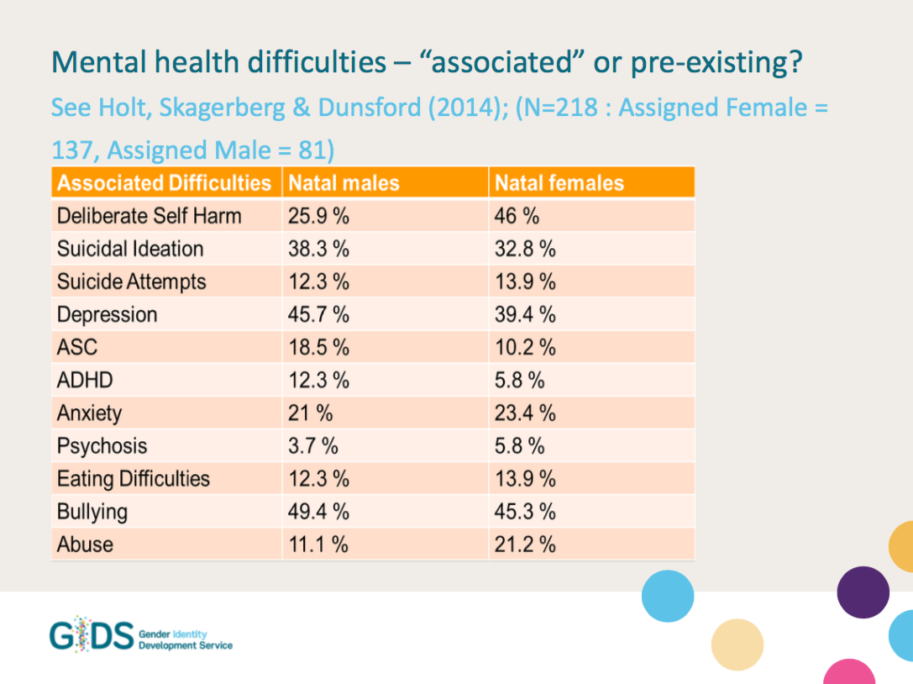

Slide 20
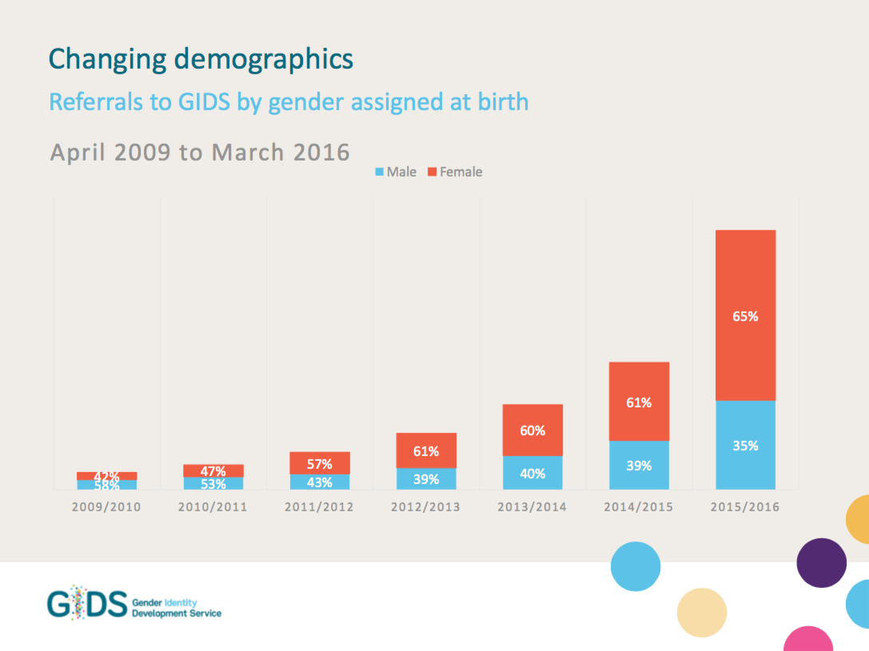

Slide 21
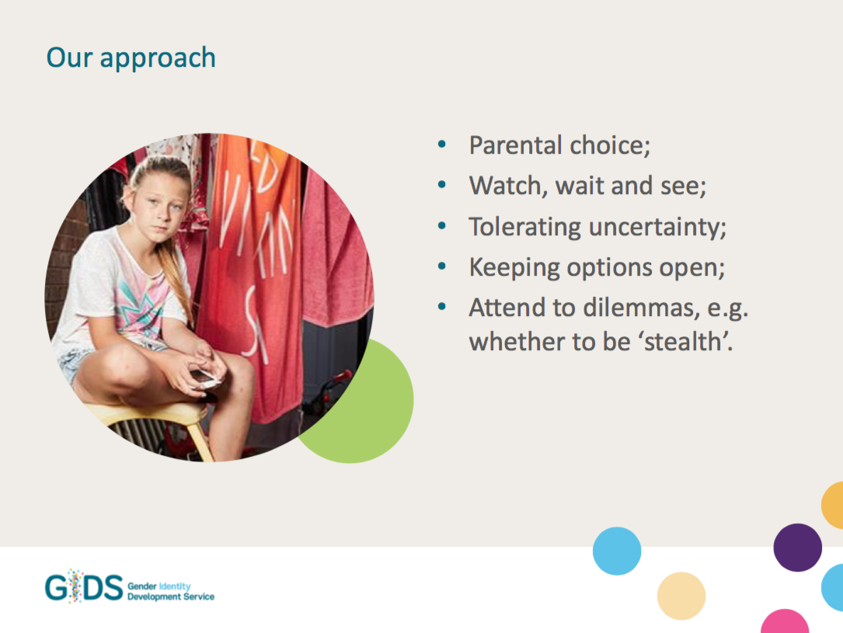

Slide 22
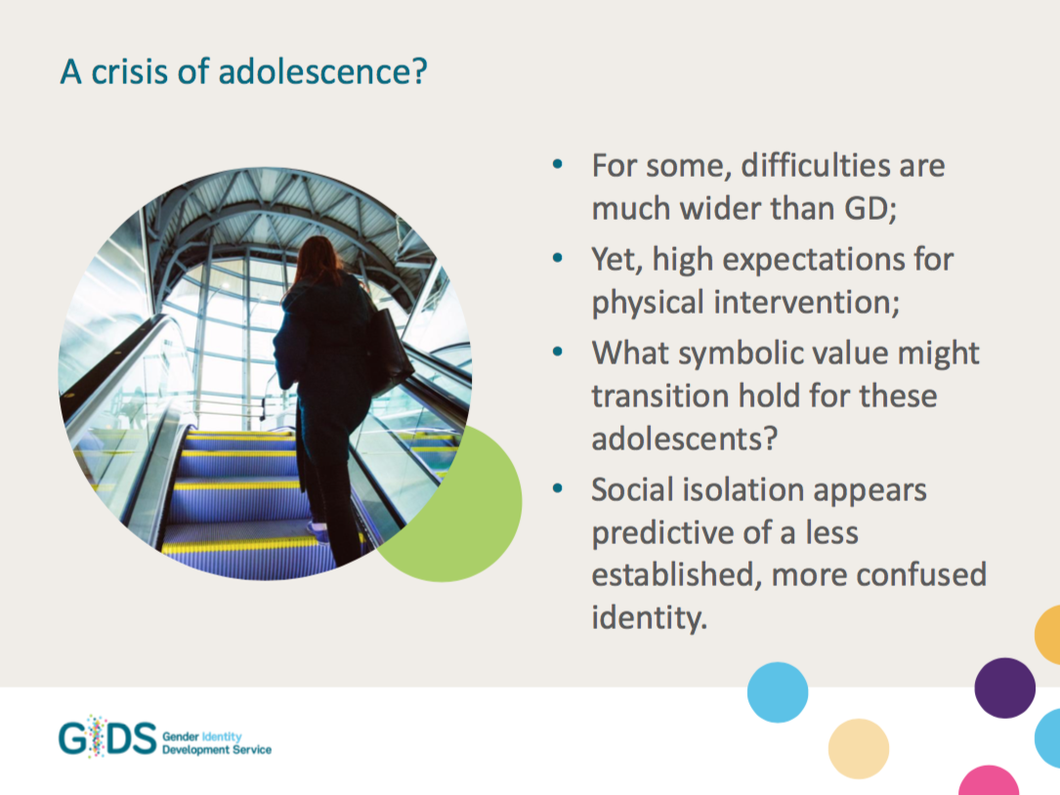

Slide 23
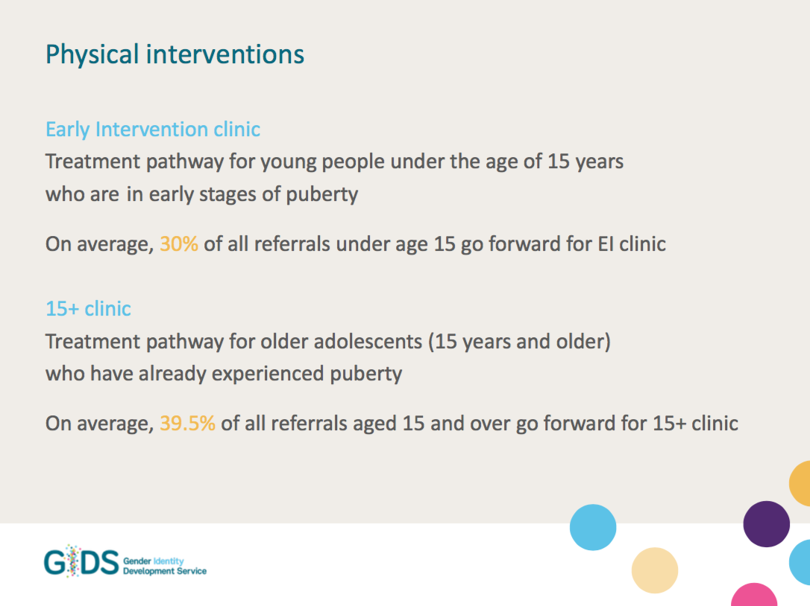

Slide 24
How to help
Psycho-education – what we know about development, education, social areas;
Watchful waiting;
Explore ideas about sexuality and families;
Listening to the narrative of the CYP;
Take a position of curiosity – what happened before/after? Wider context?
Tolerating and understanding loss – processing grief;
Making sense of who they are and where they’re at.

Slide 25
“If we weren’t so binary, there’d be nothing to transition to”

Slide 26
Resources / Further information
BPS guidelines: ‘Guidelines and literature review for psychologists working therapeutically with sexual and gender minority clients’
Brighton & Hove Trans* Inclusion Schools Toolkit: http://gids.nhs.uk/guidance-schools
Stonewall resources: http://www.stonewall.org.uk/our-work/education-resources
Notes:
Stonewall:
Inclusive curriculum guide
Posters
Anti-bullying week lesson plan (primary)
Anti-bullying week assembly (secondary)
‘Getting started’ document
Much more…

Slide 27
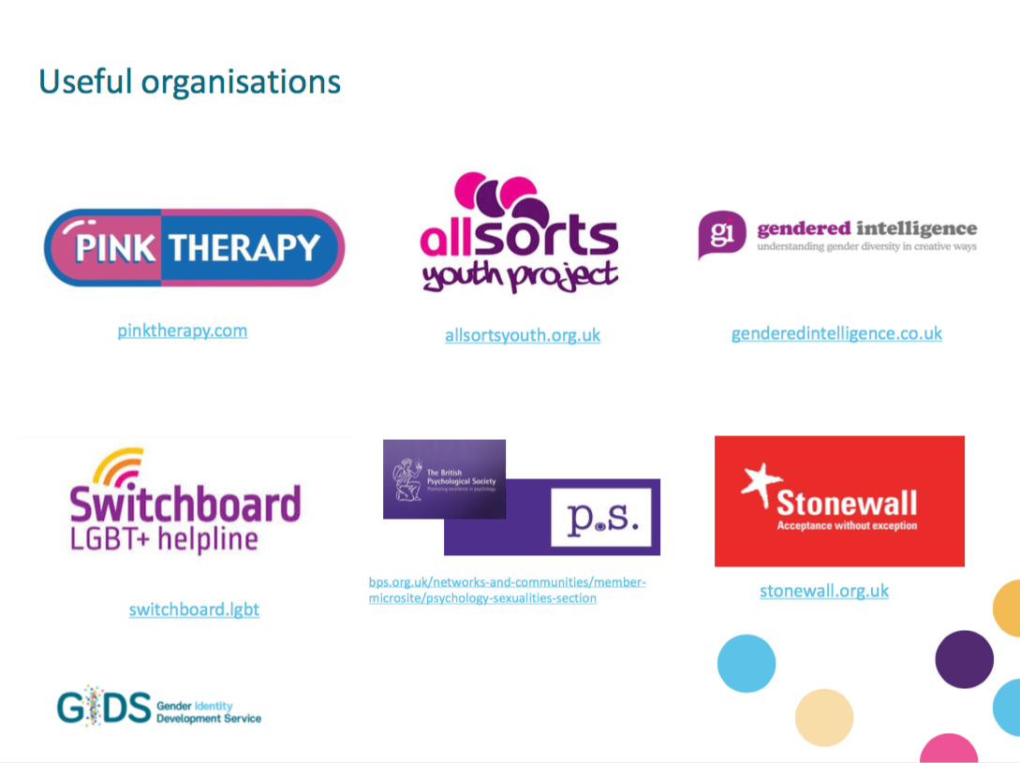

Slide 28
Questions?
(N.B. don’t ask any as we won’t know the answers)

